Slide 1
深入浅出ABP FWK
刘毅

Slide 2
Agenda
About ABP:
What is it?
Why use it?
How to use it?
How it works?
Dynamic Api Controller
Asp.Net and Asp.Net Web Api
Unit of Work
DynamicProxy

Slide 3
需求：做一个任务管理系统
Demo time

Slide 4

终于上线了

Slide 5

PM：来来来，咱们商量个事

Slide 6

PM：为了安全性，我们得做API授权验证

Slide 7

PM：我们需要审计日志，异常管理和异常日志

Slide 8

PM：客户预算不够了，把SqlServer换成MySql吧

Slide 9

我: ......

Slide 10

感觉自己掉坑里了

Slide 11
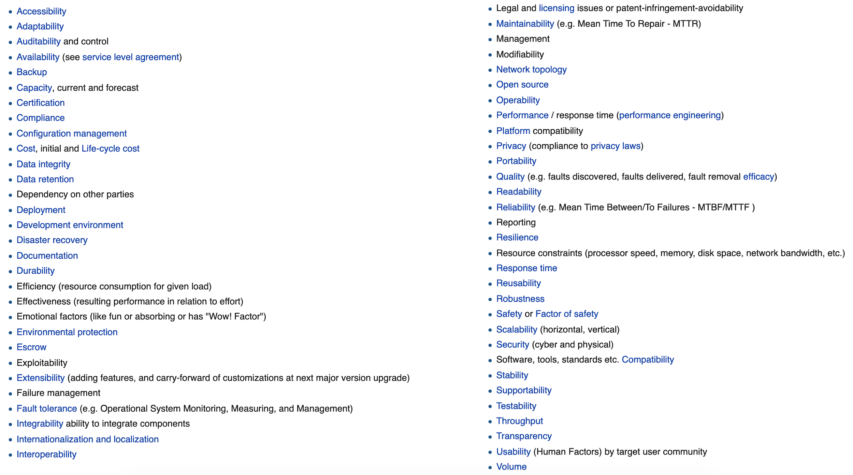
What we missing: Cross Functional Requirements

Slide 12
What is ABP?
ASP.NET Boilerplate is a general purpose application framework specially designed for new modern web applications. It uses already familiar tools and implements best practices around them to provide you a SOLID development experience.
ASP.NET Boilerplate是专为新的现代Web应用程序设计的通用应用程序框架。 它使用已经熟悉的工具并实现它们周围的最佳实践，为您提供SOLID开发体验。

Slide 13
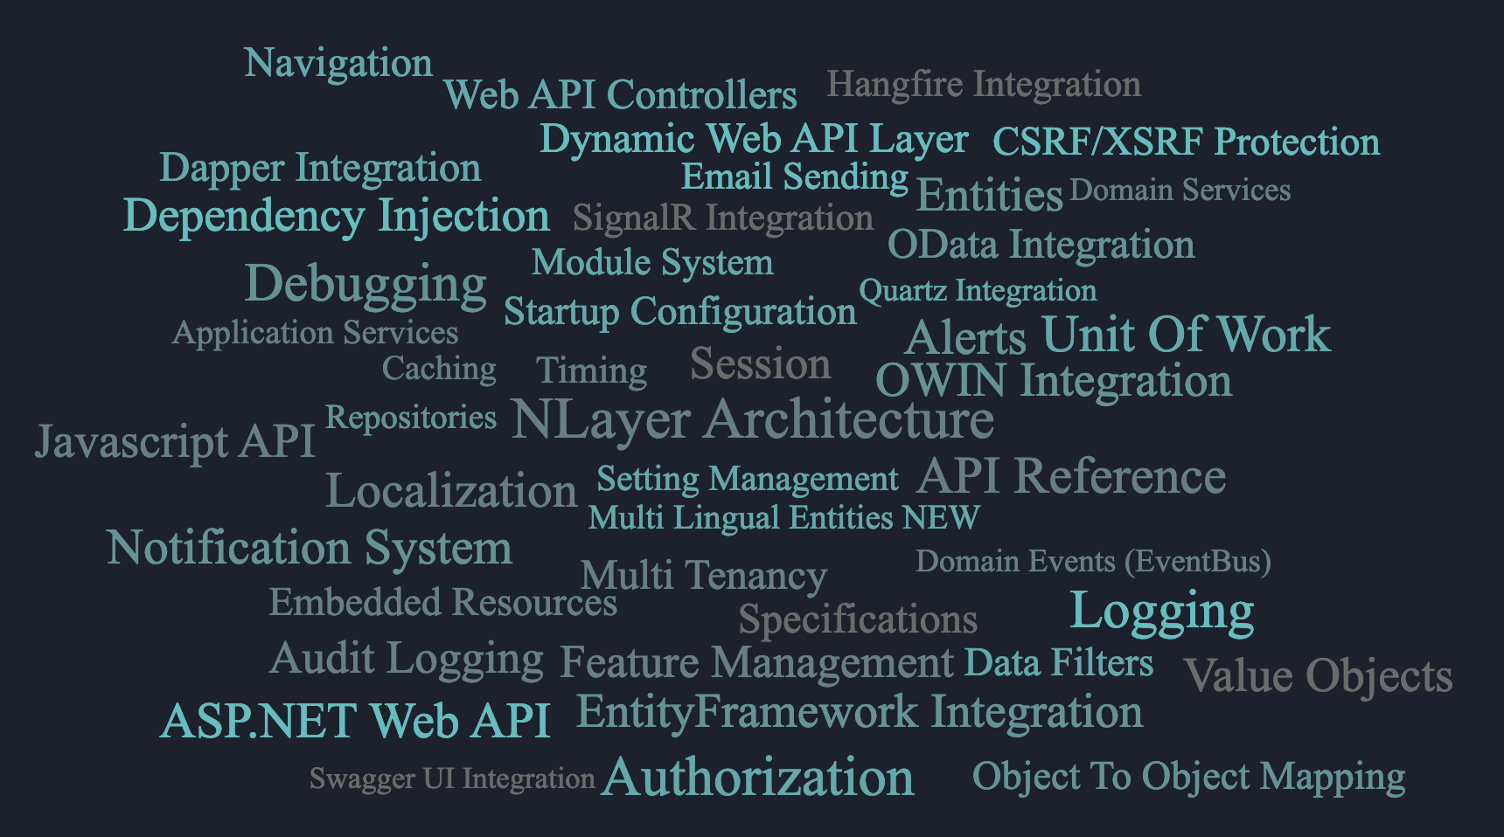
ABP include

Slide 14
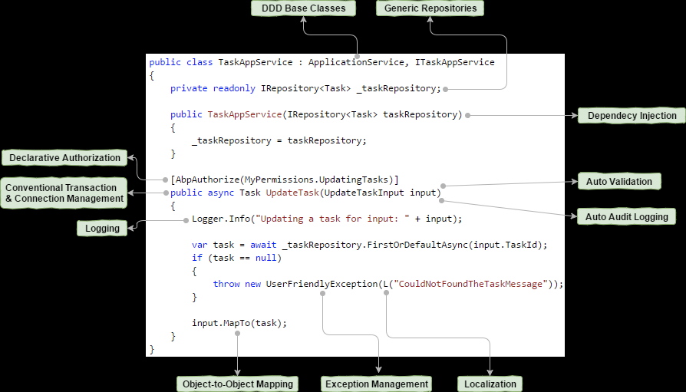
How to use ABP?
Notes:
https://github.com/aspnetboilerplate/aspnetboilerplate#how-it-works

Slide 15
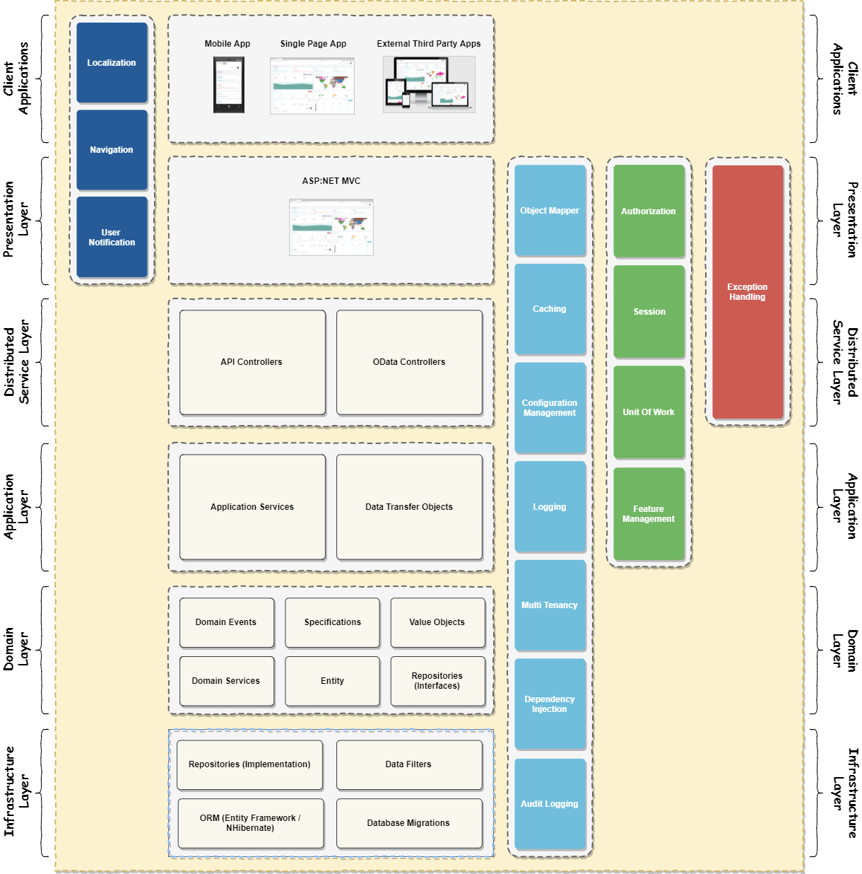
Layered Architecture
Notes:
https://github.com/aspnetboilerplate/aspnetboilerplate#layered-architecture

Slide 16
重新实现一个任务管理系统
Demo time
基于ABP

Slide 17
How it works?
以这两个Feature为切入点，来看看ABP是怎么工作的
Unit of Work
Dynamic Web API Layer

Slide 18
How it works?
以这两个Feature为切入点，来看看ABP是怎么工作的
Unit of Work
Dynamic Web API Layer

Slide 19
预备知识：先来看看什么是动态代理

Slide 20
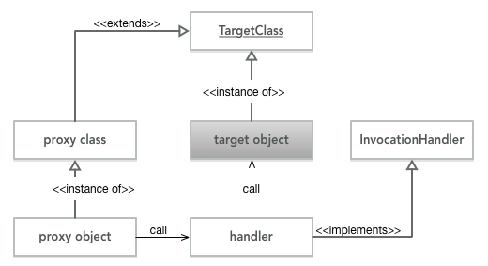
DynamicProxy

Slide 21
Unit of Work
Debug time

Slide 22
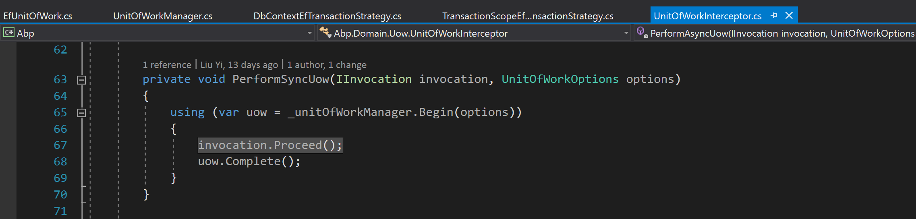
AOP: Interceptor

Slide 23
How it works?
以这两个Feature为切入点，来看看ABP是怎么工作的
Unit of Work
Dynamic Web API Layer

Slide 24
预备知识：先来看看ASP.NET和ASP.NET WebAPI是怎么工作的

Slide 25
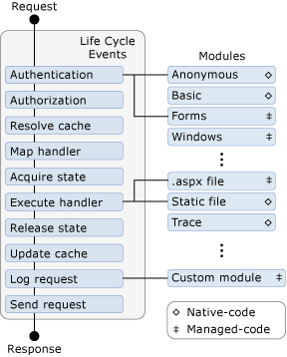
ASP.NET应用请求生命周期
关注两个事件:
ApplicationStart
PostResolveRequestCache
关注两个类:
HttpModule
HttpHandler

Slide 26
ASP.NET Web API: 关注两个问题
Web API如何开启他自己的管道？
Web API如何根据当前请求找到并实例化Controller和Action？

Slide 27
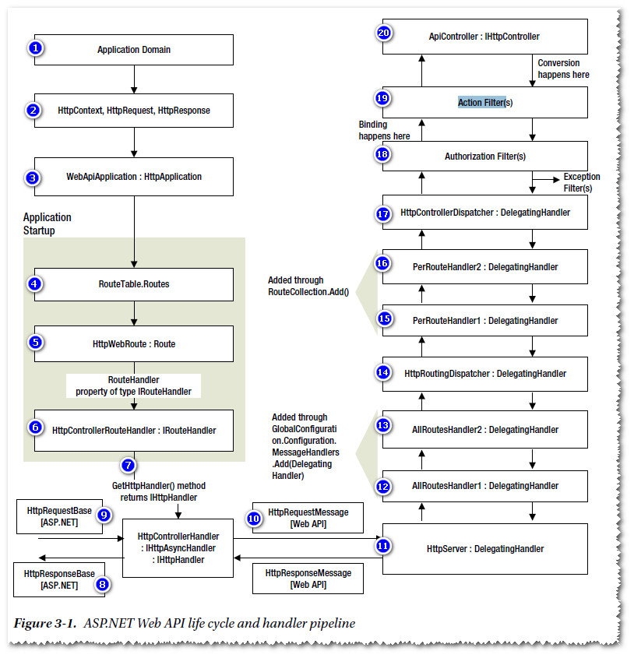
Web API如何开启他自己的管道?
Notes:
https://www.google.com/imgres?imgurl=https%3A%2F%2Fi.stack.imgur.com%2FjkQe8.jpg&imgrefurl=https%3A%2F%2Fstackoverflow.com%2Fquestions%2F26554529%2Fmessage-handlers-and-the-http-module&docid=jQTSzDXgqDfDHM&tbnid=xs1JJyGPLNODtM%3A&vet=10ahUKEwitt7mM0qzhAhURZt4KHdCnCNwQMwhHKAkwCQ..i&w=814&h=845&bih=790&biw=1527&q=asp.net%20webapi%20life%20cycle%20and%20handler%20pipeline&ved=0ahUKEwitt7mM0qzhAhURZt4KHdCnCNwQMwhHKAkwCQ&iact=mrc&uact=8

Slide 28
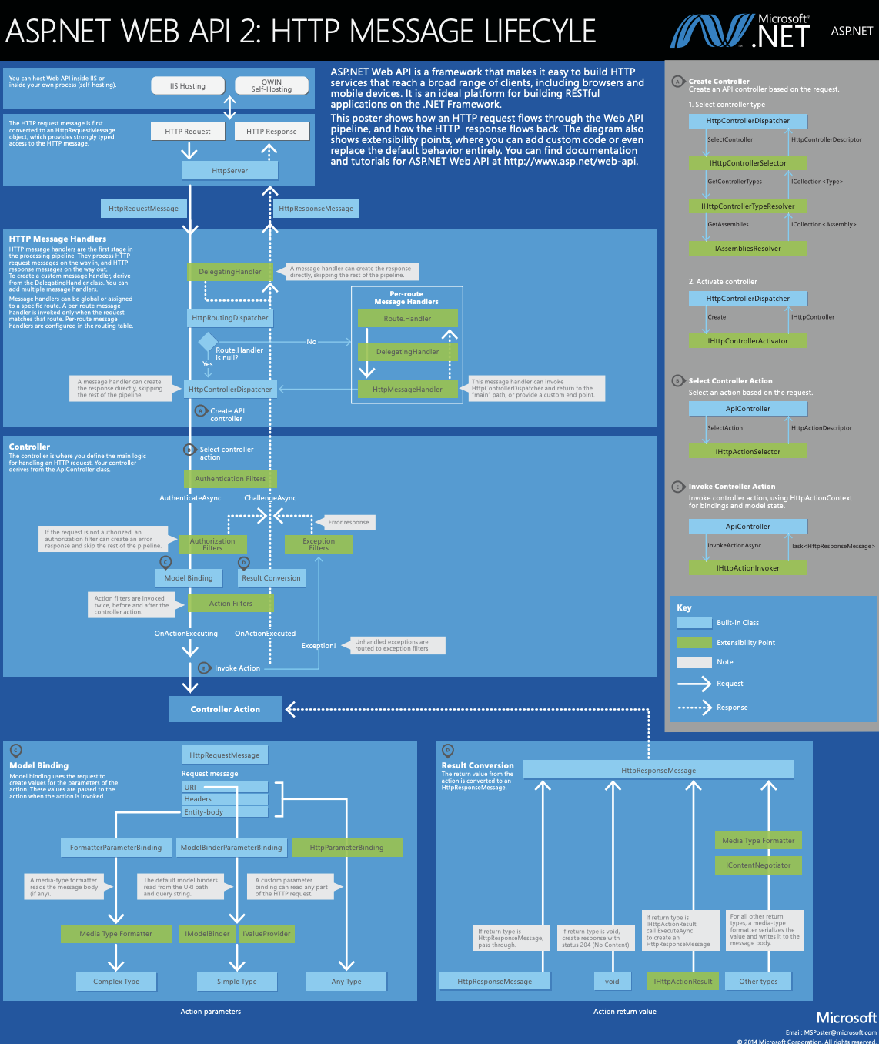
Web API如何找到并实例化Controller和Action?
Notes:
https://www.asp.net/media/4071077/aspnet-web-api-poster.pdf

Slide 29
Dynamic Web API Layer
Debug time

Slide 30
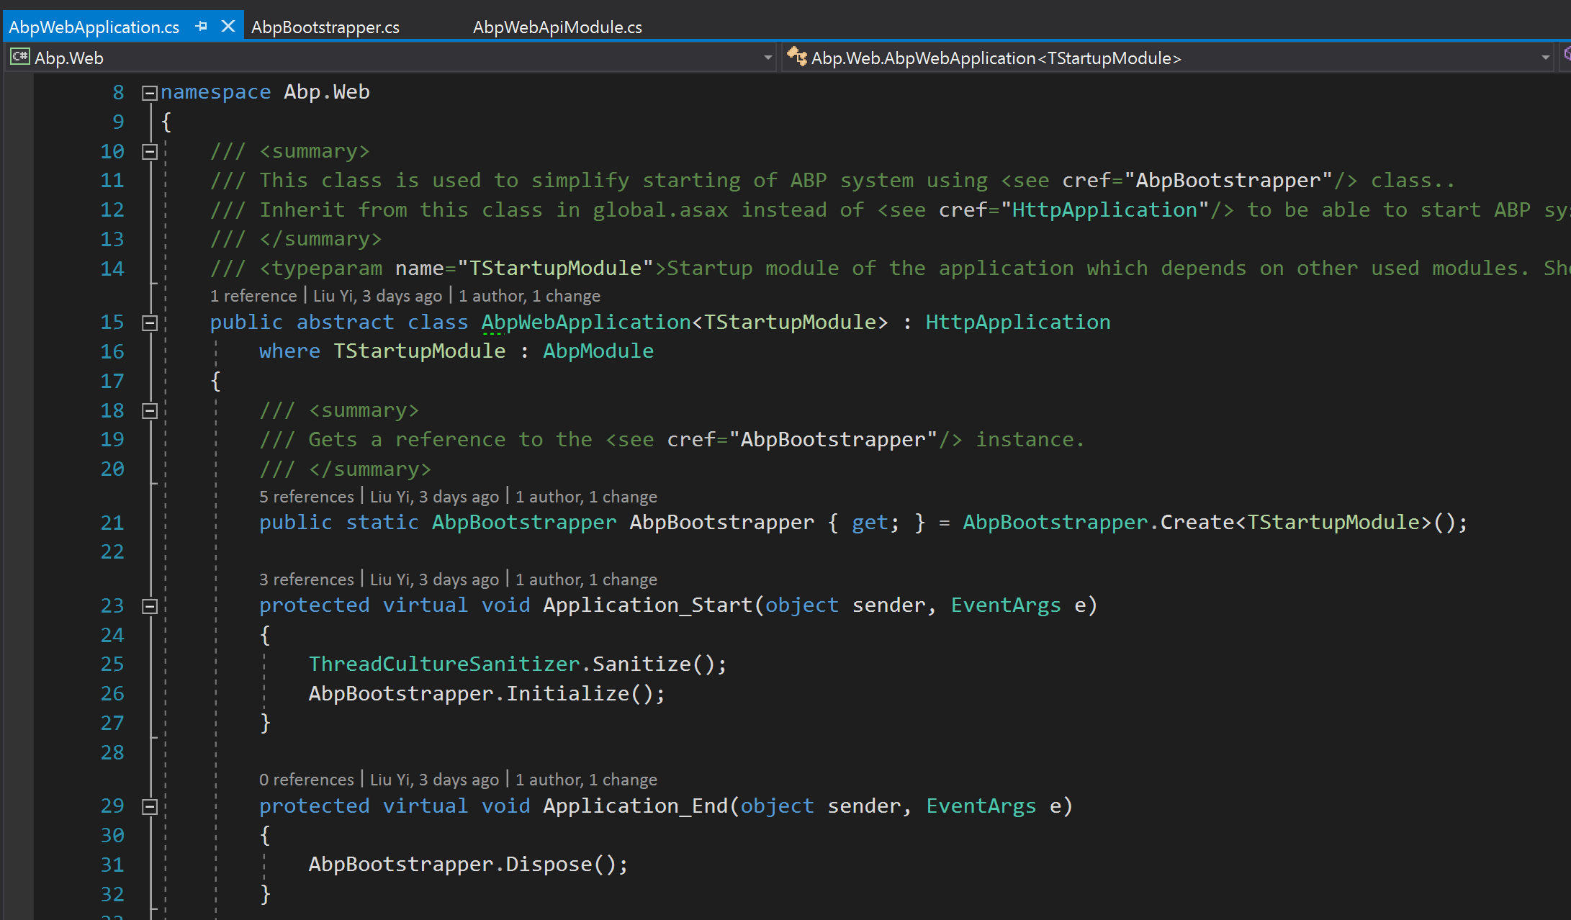
Bootstrap ABP in AbpWebApplication
Notes:
AbpWebApplication -> AbpBootstrapper
AbpWebApiModule.InitializeAspNetServices

Slide 31
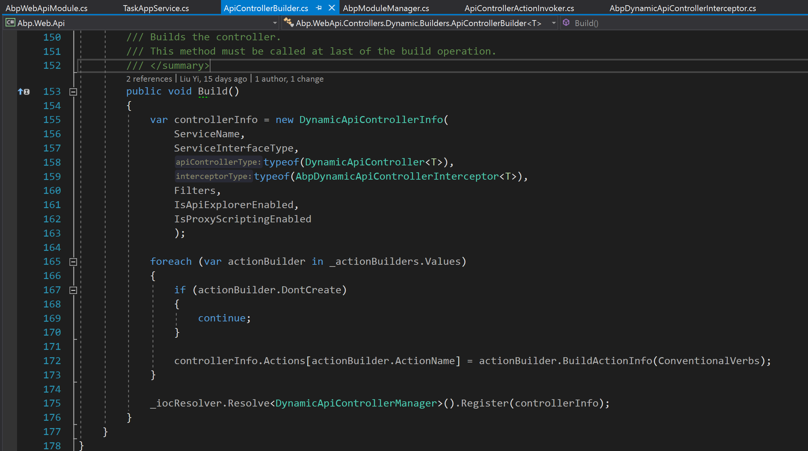
Register DynamicApiControllerInfo into Manager

Slide 32
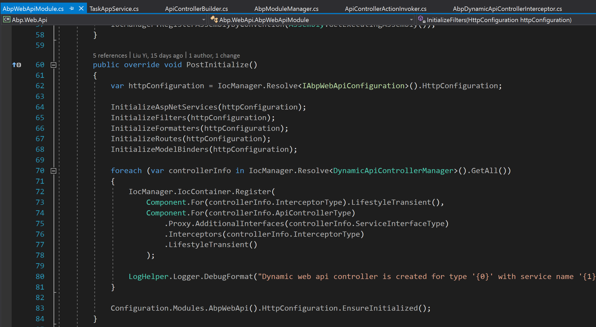
Register DynamicApiController into Ioc container

Slide 33
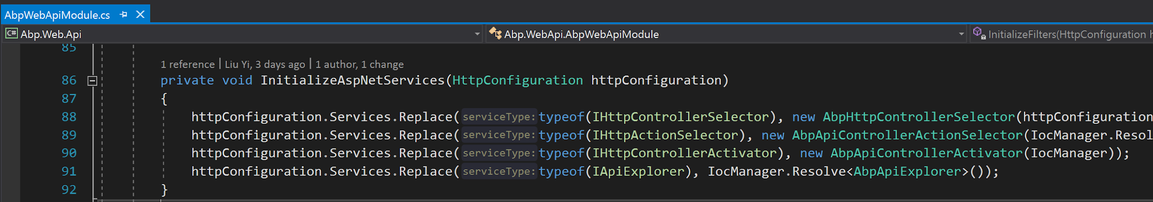
Replace Default Controller/Action Services

Slide 34
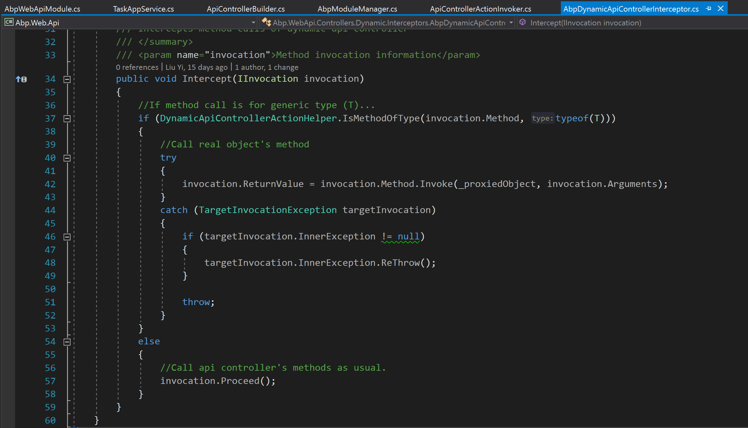
Call DynamicApiController method in Interceptor

Slide 35
Reference:
ABP official site
Debug SimpleTaskSystem with ABP source code
DynamicProxy Demo
Understanding Abp Dynamic Api
Debug ASP.NET WEB API and Katana based on source code

Slide 36

Feedback
本session涉及内容均为个人观点，资料与素材均来源于网络

